Slide 1
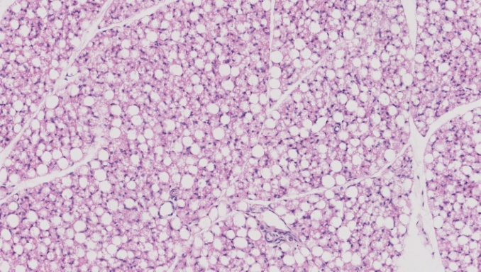
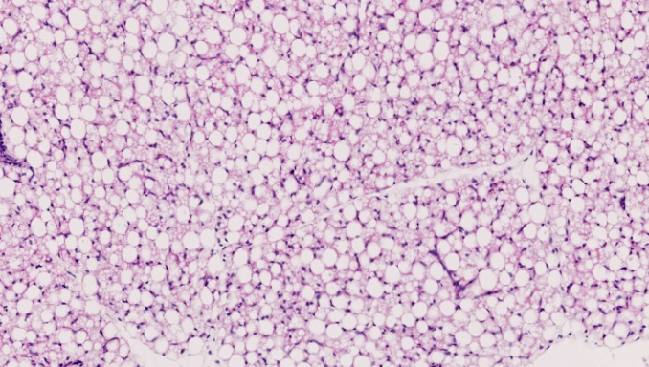
Figure 1.
(A) Treatment P<0.001
(C) Treatment P<0.05, GA P<0.001
100
100
+
*
*
UL
*
+
80
ML
80
60
60
PAT composition (%)
*
UL perimeter (µm)
40
*
40
20
20
0
0
Sham
Sham
TX
TX
(B) Treatment P<0.001 (UL only)
129 dGA
143 dGA
6
5
*
(D)
(E)
4
*
Relative PAT mass (g/kg)
3
2
1
0
100µm
100µm
Sham
TX
Sham
TX
129 dGA
143 dGA

Slide 2
Figure 2.
Notes:
Figure 2: Volcano plots using RNA-sequencing data from perirenal adipose tissue taken from Sham and thyroidectomise (TX) fetuses at 129 and 143 days of gestation (dGA). (A) Comparing data by treatment , TX and Sham; (B) gestational age, 143 and 129 dGA; (C) & (D) between gestational age (143 dGA and 129 dGA) within treatment; (E) & (F) between treatment (TX and Sham) within gestational age. Red and blue dots represent up and down-regulated differentially expressed genes, repectively (with absolute log2 fold change >=1, padj < 0.05).

Slide 3
Figure 3.
Notes:
Figure 3: Gene ontology analysis using RNA-sequencing data from perirenal adipose tissue taken from Sham and thyroidectomized (TX) fetuses at 129 and 143 days of gestation (dGA). The differential expressed genes used from the comparing data by treatment (TX and Sham) with abs(log2FoldChange) >=1 and padj < 0.05. (A) KEGG pathway bar plot indicating the number of up and down-regulated genes; (B) Gene Ontology- Biological Process (BP) bar plot indicating the number of up and down regulated genes. The red and blue bars represent up and down-regulated genes, respectively.

Slide 4
(A) Treatment P<0.001, GA P<0.001, Interaction P<0.005
(B) Treatment P<0.001, GA P<0.001
(C) Treatment P<0.001
+
15
*
3
*
8
*
+
6
*
10
2
*
IGFI mRNA (AU)
IGFII mRNA (AU)
Leptin mRNA (AU)
4
5
1
+
2
0
0
0
(D) GA P<0.001
(E) Treatment P<0.05
(F) Treatment P<0.001
*
5
+
1.5
6
*
+
4
5
3
1.0
4
ADR α1A mRNA (AU)
ADR α1D mRNA (AU)
ADR α2A mRNA (AU)
*
3
2
0.5
2
1
1
0
0.0
0
(G) Treatment P<0.005, GA P<0.05
(H) Treatment P<0.001, GA P<0.001, Interaction P<0.01
(I) Treatment P<0.001
*
2.5
*
2.0
+
3.5
2.0
3.0
+
1.5
2.5
1.5
*
2.0
ADR β1 mRNA (AU)
ADR β2 mRNA (AU)
ADR β3 mRNA (AU)
1.0
1.5
1.0
0.5
0.5
1.0
0.5
0.0
Sham
TX
Sham
TX
0.0
Sham
TX
Sham
TX
0.0
Sham
TX
Sham
TX
129 dGA
143 dGA
129 dGA
143 dGA
129 dGA
143 dGA
Figure 5.

Slide 5
(A) Treatment P<0.001, GA P<0.05, Interaction P<0.05
(B) Treatment P<0.01, GA P<0.05
8
8
+
6
6
*
+
4
4
DIO1 mRNA (AU)
DIO2 mRNA (AU)
2
2
0
*
0
(C) Treatment P<0.005, GA P<0.05
(D) Treatment P<0.001, GA P<0.05
1.5
5
*
*
*
4
*
1.0
3
TRα mRNA (AU)
TRβ mRNA (AU)
+
0.5
2
1
0
0
Sham
TX
Sham
TX
Sham
TX
Sham
TX
129 dGA
143 dGA
129 dGA
143 dGA
Figure 6.

